Slide 1

Welcome to our class
English 6
Mrs. Vu Thi Thuy Lan
Trung Nghia Secondary school

Slide 2

Unit 9.CITIES OF THE WORLD
Lesson 1 – Getting stared.
Lesson 2 – A closer look 1.
Lesson 3-A closer look 2

Slide 3
Which city is that?

Slide 4
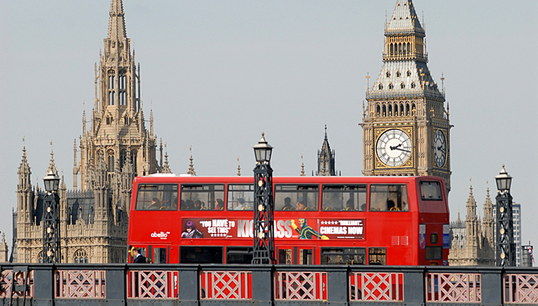
Which city is that ?
Europe
England
capital
Big Ben
London

Slide 5
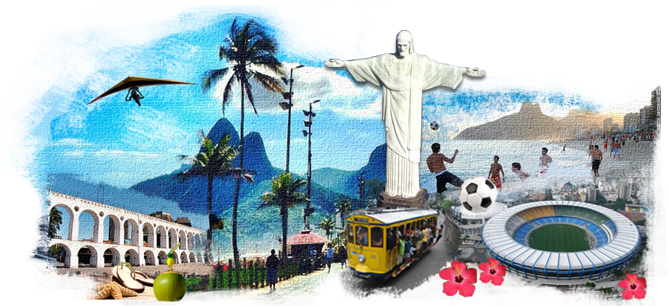
Which city is that ?
capital
South America
Brazil
The 2016 Olympic games
Rio de Janeiro

Slide 6
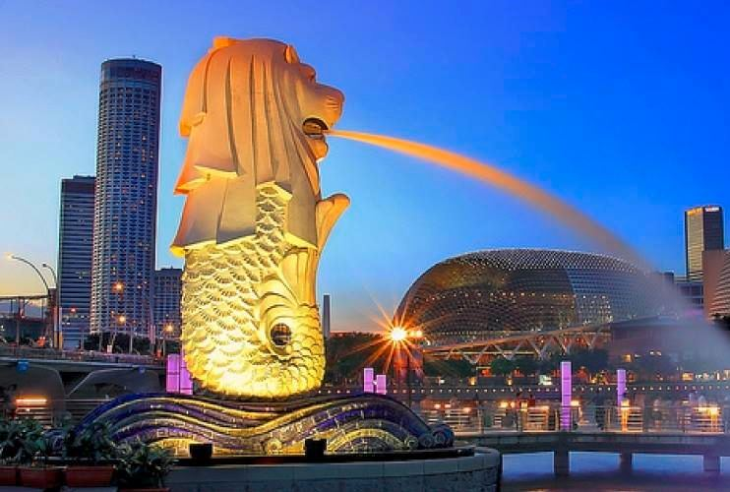
Which city is that ?
Asia
island
clean
Merlion
Singapore

Slide 7
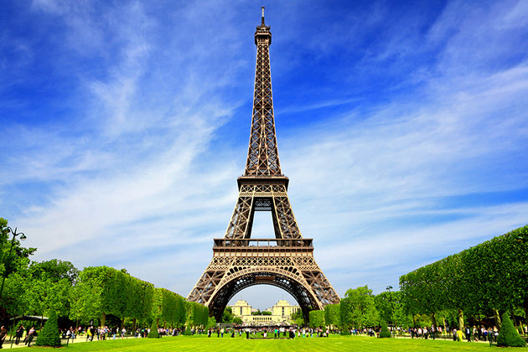
Which city is that ?
Europe
tower
capital
France
Paris

Slide 8
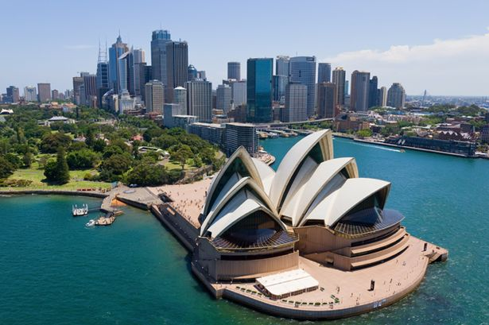
Which city is that ?
beach
Australia
Kangaroo
Opera house
Sydney

Slide 9
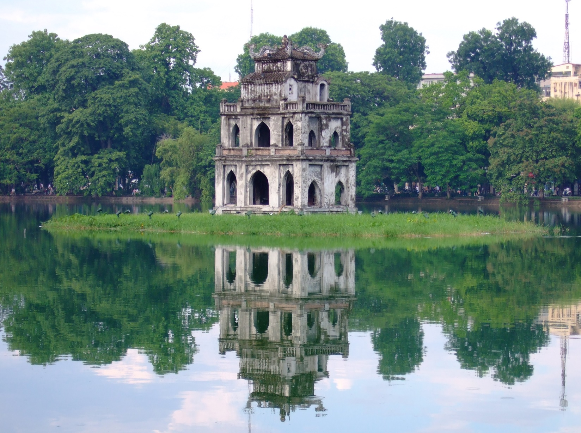
Which city is that ?
Asia
Viet Nam
Capital
Guom lake
Ha Noi

Slide 10

Which city is that ?
beach
Viet Nam
Monkey island
Vinpearl land

Slide 11
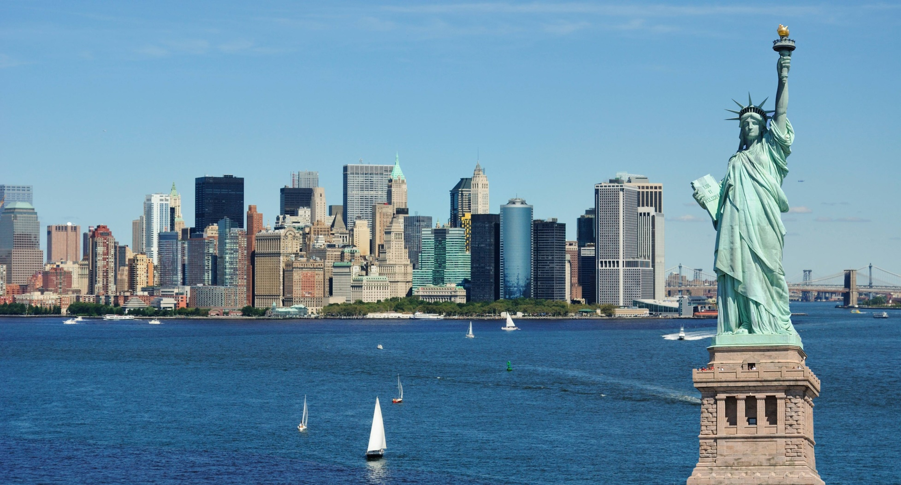
Which city is that ?
North America
The USA
Times Square
Statue of Liberty
New York

Slide 12
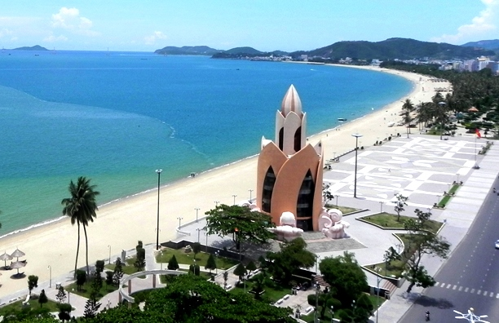
I – Grammar:
THE PRESENT PERFECT TENSE
Have you ever been to Nha Trang?
Yes, I have.

Slide 13
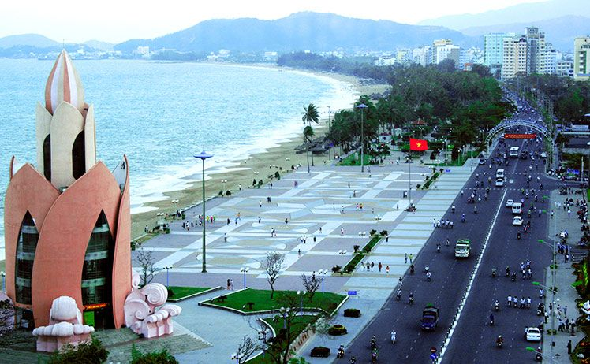
I – Grammar:
THE PRESENT PERFECT TENSE
I have been to Nha Trang 3 times.
She has been to Nha Trang many times.

Slide 14

I – Grammar:
THE PRESENT PERFECT TENSE
I have never been to Paris.
I have not been to Paris.

Slide 15
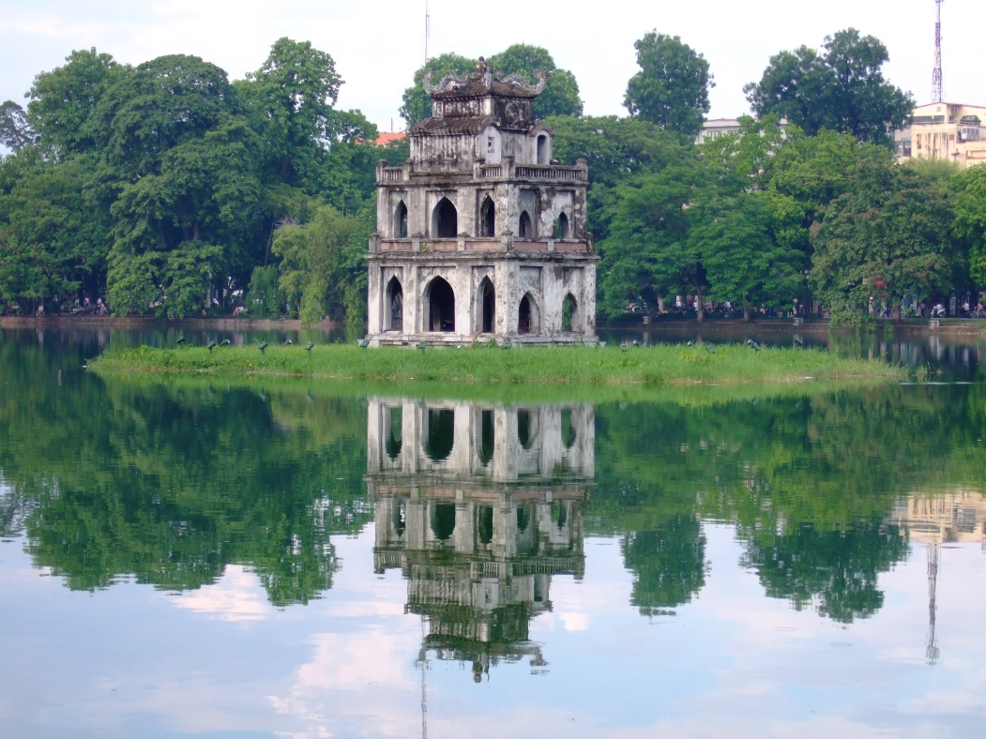
I – Grammar:
THE PRESENT PERFECT TENSE
Have you ever been to Ha Noi?
Yes, I have.
No, I haven’t.

Slide 16

1. FORM
AFFIRMATIVE ( +)
I
He/ She/ It
They/ We/ You
have
has
have
V_ed/ V3
be => been (V3)
Ex. 1. I have been to Nha Trang.
2. She has been to Nha Trang
three times.

Slide 17
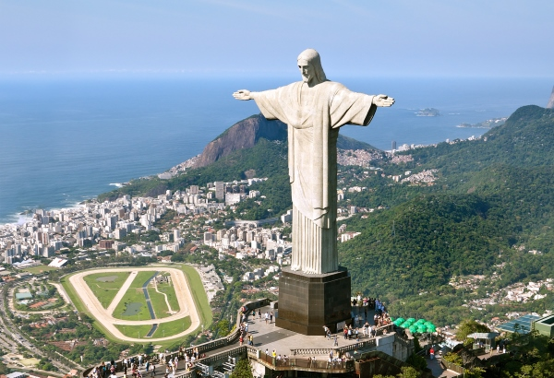
1. FORM
NEGATIVE (-)
I
He/ She/ It
They/ We/ You
have
has
have
NOT
(never)
V_ed/ V3
Ex. 1. I have never been to Rio de Janeiro.
2. We have not been to Rio de Janeiro.

Slide 18

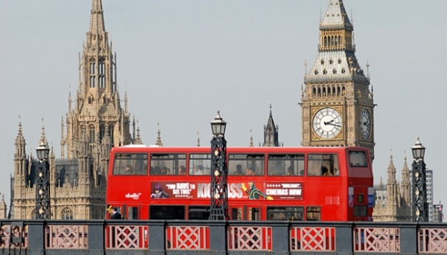
1. FORM
QUESTIONS (?)
Have
Has
Have
I
he/ she/ it
they/ we/ you
(ever)
V_ed/ V3?
Ex. 1. Have you ever been to Nha Trang?
Yes, I have.
2. Have you ever been to London?
No, I haven’t.

Slide 19
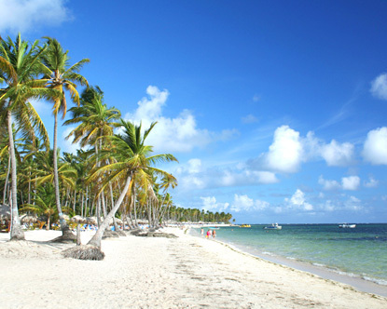

2. USES
To describe our experiences when the exact time is not important.
(dùng để miêu tả các trải nghiệm/ việc đã từng làm, không cần xác định thời gian)
Ex: I have been to the beach many times.
I have never been to London.

Slide 20
3. Markers
ever (đã bao giờ)
never
once ( one time) / twice…
( two, three…..) times, many times.

Slide 21
* Some V3/ Ved:
1. be
2. see
3. visit
4. eat
5. play
6. get
7. wash
8. sing
9. have
10. talk
11. go
12. read
- seen
- visited
- eaten
- read
- played
- got
- sung
- had
- gone
- talked
- been
- washed
ttps://quizlet.com/189000753/unit-9-closer-look-2-flash-cards/

Slide 22


HAVE BEEN/ HAS BEEN
Where has he been ?
He has been to the supermarket.
He has been to Sydney.

Slide 23


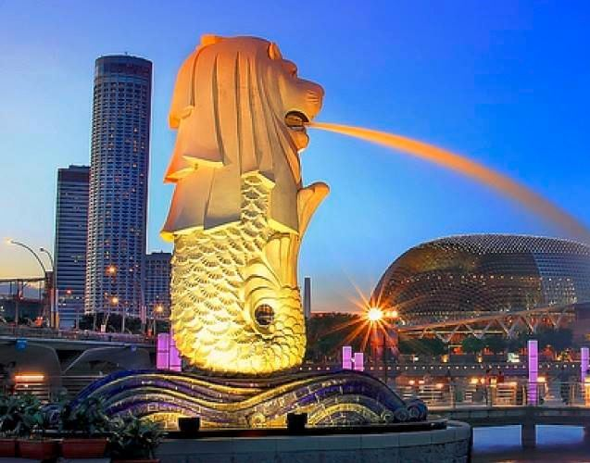
HAVE BEEN/ HAS BEEN
Where has she been ?
She has been to Singapore.
She has been to New York.

Slide 24
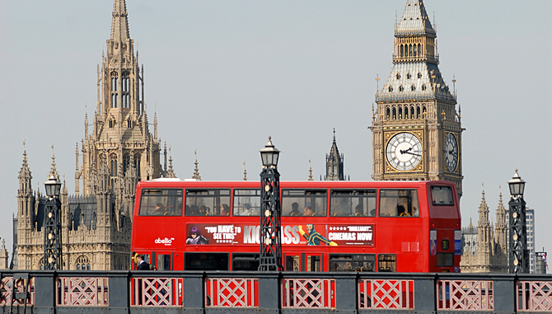
Act 1 – Put the verbs into the present perfect.
II - Practice
1. Tom (be)……………… to Rio de Janeiro, Sydney and London.
has been

Slide 25
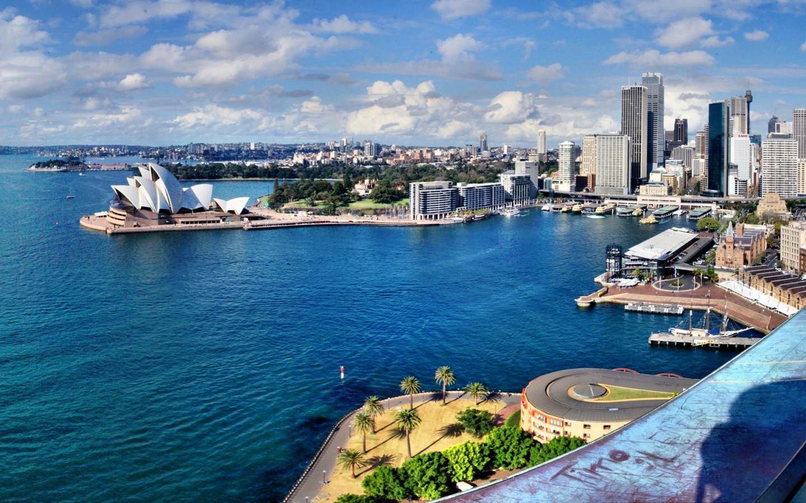
II - Practice
Act 1 – Put the verbs into the present perfect.
has been
2. The family (be)………….. to the beaches in Sydney many times.

Slide 26
Act 1 – Put the verbs into the present perfect.
II - Practice
has visited
3. Tom (visit)..………….. London twice.

Slide 27
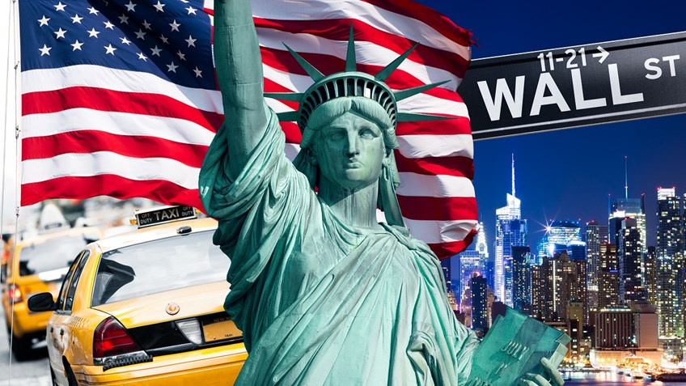
Act 1 – Put the verbs into the present perfect.
II - Practice
has been
4. His brother (be)..………….to New York.

Slide 28
Act 1 – Put the verbs into the present perfect.
II - Practice
hasn’t been
5. But Tom (be)……..………….there.

Slide 29
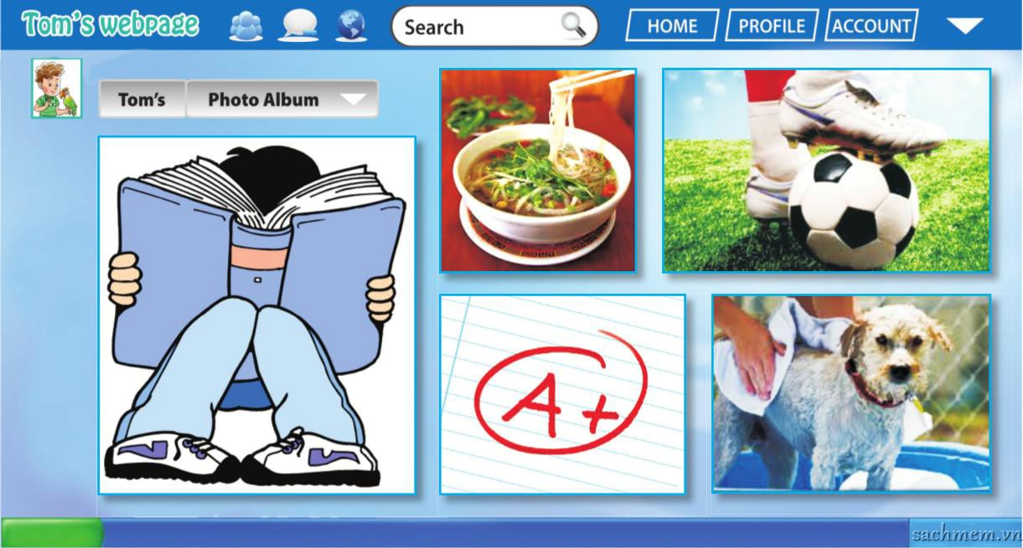
Act 2 – What has Tom done this week?
Tom has…….
II - Practice
2
3
eaten “pho”
played football
4
1
5
got an A mark
washed his dog
read a book

Slide 30


Act 3:
Who's a millionaire?
500:5
50:50
D. 12
L
F

Slide 31



Who's a millionaire?
____ you (see)____ High School Musical?
- Oh yes, I love it. I (see) ___ it many times.
50:50
B. Have/ seen – have seen
A. Do/see – see
B. Have/ seen – have seen
C. Has/seen – has seen
D. Does/see – see
L
F

Slide 32
Who's a millionaire?
I often (go) _____ to bed very late.
50:50
A. have gone
B. go
B. go
C. goes
D. has gone
L
F

Slide 33
Who's a millionaire?
They (clean) _____ the car every week.
50:50
50:50
A. cleans
B. have cleaned
C. has cleaned
D. clean
D. clean
L
F

Slide 34
Who's a millionaire?
I ____ never (be) _____ on TV.
50:50
A. have/ been
A. have/ been
B. has/ been
C. haven’t/ been
D. hasn’t/ been
L
F

Slide 35
Who's a milionaire?
Thu usually (take) _____ the bus to school.
50:50
A. has taken
B. have taken
C. takes
C. takes
D. take
L
F

Slide 36
Who's a millionaire?
My sister loves that restaurant and
she (eat) ____ there hundreds of times.
50:50
50:50
A. Has eaten
A. has eaten
B. eats
C. have eaten
D. eat
L
F

Slide 37
Act 3 – Group survey.
II - Practice
 | Yes ✔ | No ✘
1. Have you ever sung karaoke? | ✔✔✔✔✔
2. Have you ever talked on the phone for one hour?
3. Have you ever been on TV? |  | ✘✘✘✘✘
4. Have you ever eaten ice cream in winter?
5. Have you ever had a pet?
6. Have you ever talked to a native speaker of English?

Slide 38
Act 3 – Group survey.
II - Practice
Tell to the class:
One thing that everyone has done.
One thing that no one has done.
We have ……
We have never ………..

Slide 39
III.Homework
1. Write 5 sentences about what you have done this week.
2. Do exercise 3,4 (30/SB); 5,6,7 (17,18/WB)
3. Prepare new lesson: Communication

